Slide 1
Employee Data Analysis using Excel
STUDENT NAME: S.Harithra
REGISTER NO: 312216839
DEPARTMENT: B.com Bank Management
COLLEGE : Shri krishnaswamy college for women

Slide 2
PROJECT TITLE
Employee Performance Analysis using Excel

Slide 3


AGENDA
Problem Statement
Project Overview
End Users
Our Solution and Proposition
Dataset Description
Modelling Approach
Results and Discussion
Conclusion
3/21/2024 Annual Review

Slide 4

PROBLEM STATEMENT
1. Bais in AI decsion making.
2. Inadequate proection of user privacy.
3. Lack of transparency in AI algorithm.
4. Vulnerability to adversarial attacks.
5. Insufficient explanability in AI models.

Slide 5

PROJECT OVERVIEW
1.OBJECTIVE : Develop a frame work to ensure ethical AI development and deployment.
2.PROBLEM STATEMENT : AI systems can perpetuate bias, lack transparency and pose privacy risks.
3.SCOPE : focus on bias transparency explainability and accountability in AI systems.
.

Slide 6
4. MOTIVATION : Need for ethical AI to avoid harm and ensure trust .
5. GOALS :
1. Promote fairness and Transparency in AI
2. Enhance accountability and Explainability
3. Encourage responsible AI Development

Slide 7

WHO ARE THE END USERS?
1.Buisness leaders and executive.
2.Data scientists and AI developers.
3.Ethicists and philosophers.
4.Policy makers and regulators.
5.Researchers and academics.

Slide 8
OUR SOLUTION AND ITS VALUE PROPOSITION
OUR SOLUTION :
1.360degree performance visibility.
2.Automated reporting and dashboards.
3.Customized performance metrics.
4.Identification of strengths , weakness and development needs.
5.Data driven insights for formed decision making.

Slide 9
THE VALUES :
1. Maximize employee productivity and engagement.
2. Optimize talent development and succession planning.
3. Enhance leadership decision making with data driven insights.
4. Improve communication and feedback .
5. Boost overall organisational performance and competitiveness

Slide 10
Dataset Description
DATASET NAME : Employee performance data
Description: This data set contains employee performance data for a sales numbers customer satisfaction ratings task completion rates and more.
DATA SOURCE : HR database, sales records, customer feedback surveys , etc.

Slide 11
THE "WOW" IN OUR SOLUTION
1. Automated data visualization with just one click the solution generates interactive and dynamic dashboard providing real time insights into employee performance
2. AI powered predtove analytics the solution uses machine algorithms to forecast employee performance
3.customizable performance maretics uses can easily create and tract tailored performance metrics alignment .
3/21/2024 Annual Review
11

Slide 12
MODELLING
1. INPUT DATA :
Employee information
Performance metrics
Time period
2. DATA VALIDATION:
Ensure data accuracy and consistency
Handle missing and errorness
12

Slide 13
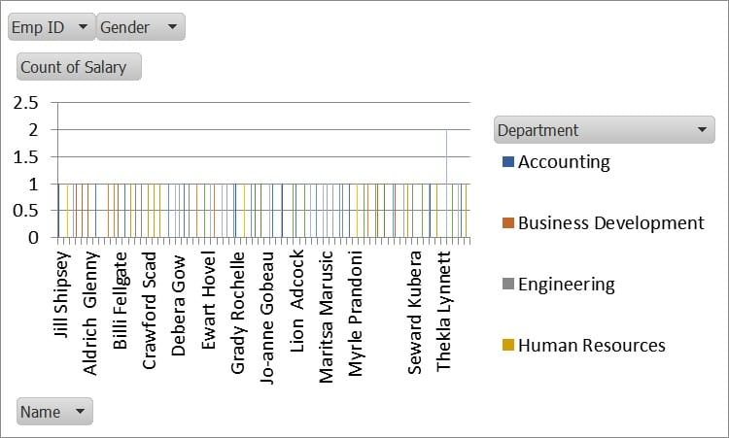
RESULTS
1.Employment performance score cards.
2. Performance metrics trends
3. Top performances and under performances
13

Slide 14
conclusion
1. STREAM LINE PERFORMANCE TRACKING AND ANALYSIS
2.IDENTIFY AREAS AND DEVELOPMENT AND IMPROVEMENT
3. ENHANCE EMPLOYEE ENGAGEMENT AND RETENTION
4.IMPROVE OVERALL ORGANISATIONAL PERFORMANCE

